Slide 1

Chapter 4
Galactaic Mail
Game Development 1
Denis McCarthy
E-mail: demccarthy@ait.ie
Room: U302

Slide 2
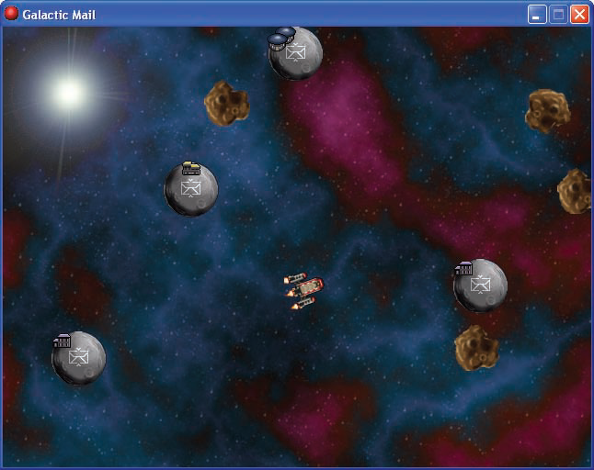
Galactic Mail
You play an intergalactic mail carrier who must deliver mail to a number of inhabited moons. He must safely steer a course from moon to moon while avoiding dangerous asteroids.
The mail carrier is paid for each delivery he makes, but pay is deducted for time spent hanging around on moons. This adds pressure to the difficult task of orienting his rickety, old rocket, which he cannot steer very well in space.
Game Development 1
Denis McCarthy

Slide 3
Galactic Mail
When the rocket is on a moon, the arrow keys will rotate it to allow the launch direction to be set. The spacebar will launch the rocket, and the moon will be removed from the screen to show that its mail has been delivered. In flight, the rocket will keep moving in the direction it is pointing in, with only a limited amount of control over its steering using the arrow keys.
When things move outside the playing area, they reappear on the other side to give the impression of a continuous world. The player will gain points for delivering mail, but points will be deducted while waiting on a moon. This will encourage the player to move as quickly as possible from moon to moon. There will be different levels, with more asteroids to avoid. The game is over if the rocket is hit by an asteroid, and a high-score table will be displayed
Game Development 1
Denis McCarthy

Slide 4
Game Resources
All resources needed for this game are stored on moodle under Lab resources Simple Shooter game.
Download all files and store in a directory
  E.g. denis\galactic_mail
Game Development 1
Denis McCarthy
Notes:
Show moodle image

Slide 5
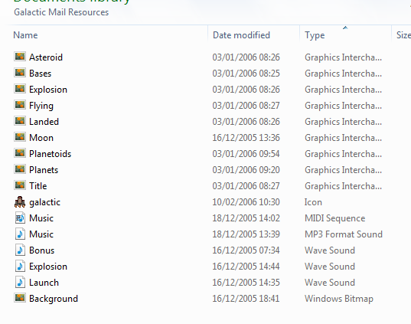
Game Resources
Sprites:
  Asteroid.gif
  Bases.gif
  Explosion.gif
  Flying.gif
  Landed.gif
  Moon.gif
  Planetoids.gif
  Planets.gif
  Title.gif
Background:
  Background.bmp
Sounds:
  Music.mp3
  Bonus.wav
  Explosion.wav
  Launch.wav
Icon:
  galactic.ico
Game Development 1
Denis McCarthy

Slide 6
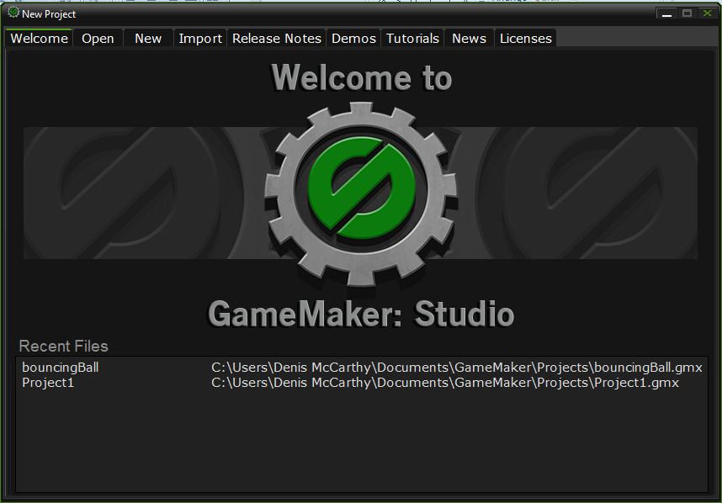
Start Game Maker
Game Development 1.1.1
Denis McCarthy

Slide 7
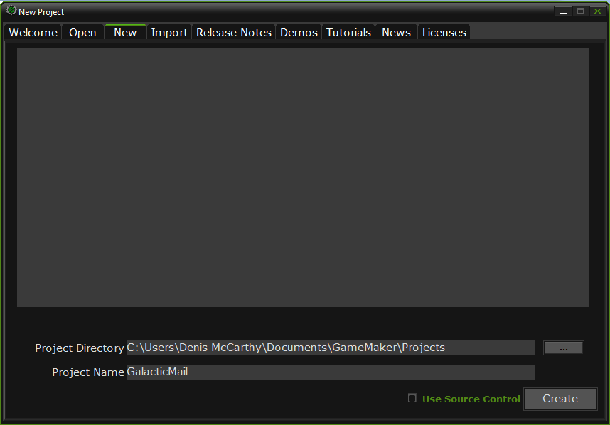
Create a new project
Call the project GalacticMail
And click on the Create button.
Game Development 1.1.1
Denis McCarthy

Slide 8
Moon Sprite
From the Resources menu, choose Create Sprite
In the Name field in the Sprite Properties form, type the name sprite_moon.
Click the Load Sprite button and choose the file moon.gif
Enable the Smooth edges option by clicking on the box next to it. This will make the edges of the sprite look less jagged during the game by making them slightly transparent.
Game Development 1
Denis McCarthy

Slide 9
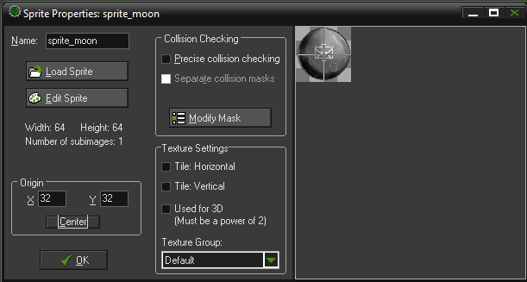
Moon Sprite
The controls for setting the origin are halfway down the second column of the form. Click the Center button to move the origin to the middle of the sprite. You should now see a cross in the middle of the sprite’s image indicating the position of the origin. You can also change the origin by clicking on the sprite image with the mouse or typing in the X and Y values directly..
Click OK at the bottom left of the form to close it.
Game Development 1
Denis McCarthy

Slide 10
Other sprites
Now create asteroid and explosion sprites in the same way using Asteroid.gif and Explosion.gif (remember to center their origins too).
We’ll need two sprites for the rocket: one for when it has landed on a moon and one for when it is flying through space. Create one sprite called sprite_landed using Landed.gif and another called sprite_flying using Flying.gif. Center the origins of these two sprites as before.
Game Development 1
Denis McCarthy

Slide 11

Sprites so far...
Your game should now have five different sprites.
Next let’s add some sound effects and background music so that they are all ready to use later on.
Game Development 1
Denis McCarthy

Slide 12
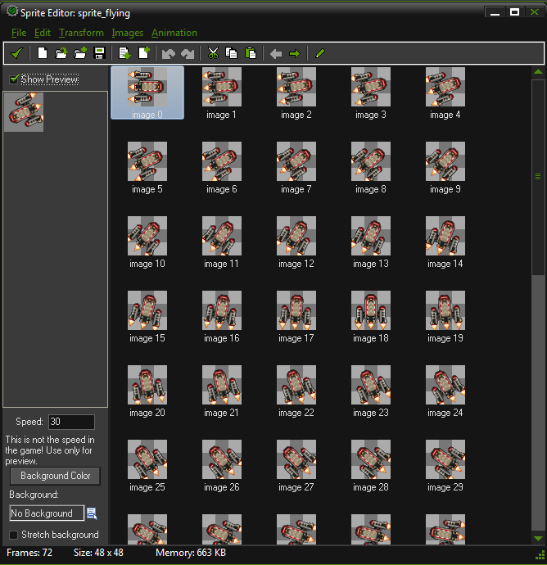
The Flying Sprite
Before closing the Sprite Properties form for the flyingsprite, click the Edit Sprite button.
A form will appear like the one shown If you scroll down the images contained in this sprite, you’ll see that it contains an animation of the rocket turning about a full circle.
There are 72 different images at slightly different orientations, making up a complete turn of 360 degrees. We’ll use these images to pick the correct appearance for the rocket as it rotates in the game.
We can use the Sprite Editor to change the sprite in many ways, but for now simply close it by clicking the button with the green checkmark in the top left of the window.
Game Development 1
Denis McCarthy

Slide 13
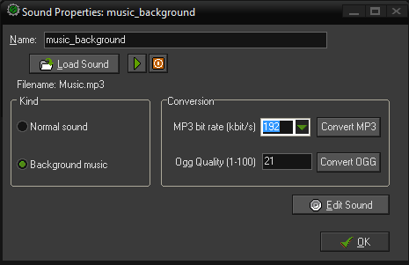
Adding Music
We are going to create three sounds
  Music to play in the background.
  A sound effect of an explosion.
  A sound effect for a bonus.
Select Create Sound from the Resources menu.
Call the background music music_background and click on the Load Sound button and choose the file Music.mp3.
Click OK to close the Sound Properties form.
Game Development 1
Denis McCarthy

Slide 14
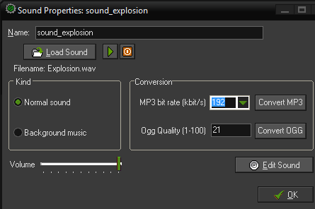
Sound Effects
Select Create Sound from the Resources menu.
Call the clicking sound sound_explosion and click on the Load Sound button and choose the file Eplosion.wav.
Click OK to close the Sound Properties form.
Game Development 1
Denis McCarthy

Slide 15
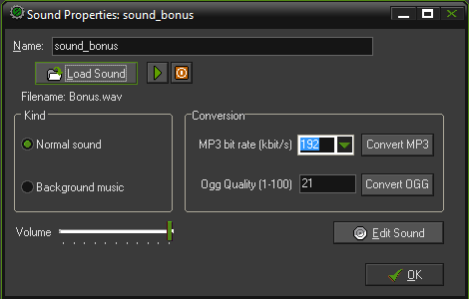
Sound Effects
Select Create Sound from the Resources menu.
Call the clicking sound sound_bonus and click on the Load Sound button and choose the file Bonus.wav.
Click OK to close the Sound Properties form.
Adding all these resources at the start will make it easier to drop them into the game as we are going along—so let’s get started on some action.
Game Development 1
Denis McCarthy

Slide 16
Moons and Asteroids
Both moons and asteroids will fly around the screen in straight lines, jumping to the opposite side of the room when they go off the edge of the screen.
In Game Maker this is called wrapping, and it is done using the Wrap Screen action.
Game Development 1
Denis McCarthy

Slide 17
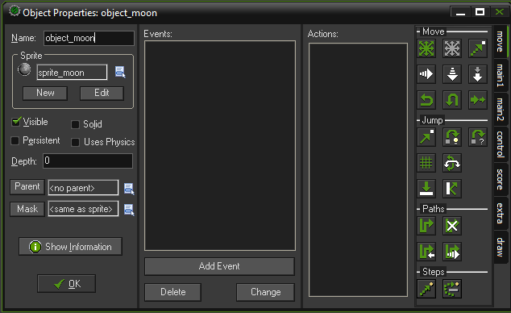
The Moon Object
From the Resources menu, choose Create Object
In the Name field, give the object a name. You should call this one object_moon
Click the icon at the end of the sprite field and a list of all the available sprites will appear. Select the sprite_moon sprite.
Game Development 1
Denis McCarthy

Slide 18
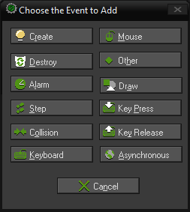
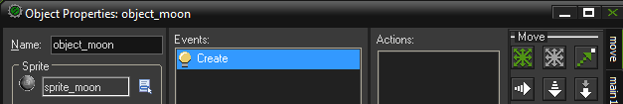
Adding events to Moon object
Click the Add Event button. The Event Selector appears as shown below.
Click the Create event and this event will then be added and selected in the list of events.
Game Development 1
Denis McCarthy

Slide 19
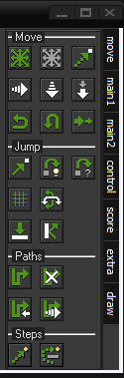
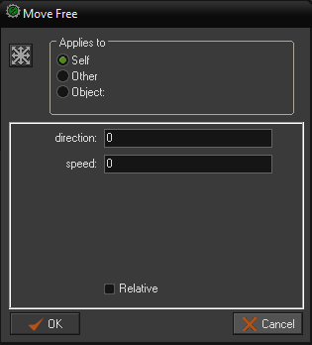
Adding Movement Action
We need to select the Move Free action from the move action tab category. Drag and drop the Move Fixed icon by holding down the left mouse button. An action form will then pop up asking for particular information about this action.

Slide 20
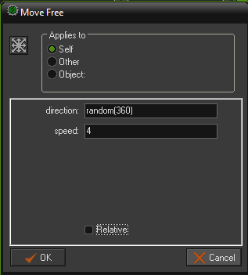
Adding Movement Action
When a moon is created, we want it to start moving in a completely random direction. To achieve this we enter the function random(360) into the direction field. This indicates a random direction between 0 and 360 degrees.
Set the speed 4.
Click on OK to create action.

Slide 21
Moon outside room
We also need to make sure that when the moon goes off the edge of the room, it reappears at the other side.
To achive this we include the wrap function.
Game Development 1
Denis McCarthy

Slide 22
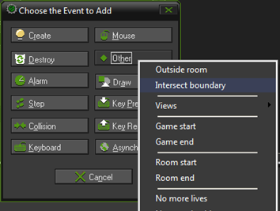
Outside Room Event
Click the Add Event button. The Event Selector appears as shown below.
Click the Other event and select Outside Room from the drop down menu that appears to add it to the list of events. This event will then be added and selected in the list of events.
Game Development 1
Denis McCarthy

Slide 23
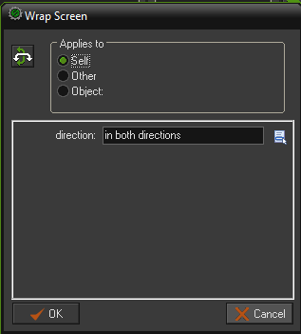
Adding Wrap action
Include the Wrap Screen action in the Actions list.
In the form that appears, you should indicate that wrapping should occur in both directions (top to bottom and left to right).
Click on OK to finish.

Slide 24
Wrap Screen Action
Wrap Screen
With this action you can let an instance wrap around, that is, when it leaves on one side of the room it reappears at the other side. This action is normally used in the Outside event. Note that the instance must have a speed for wrapping to work, cause the direction of wrapping is based on the direction of the motion. You can indicate whether to wrap only horizontal, only vertical, or in both directions.
Game Development 1
Denis McCarthy

Slide 25
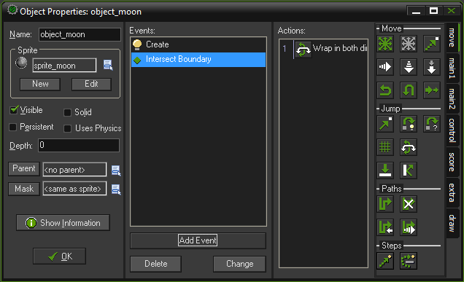
Moon object, complete so far…
That’s all the events and actions that we need for the Moon object right now.
Click OK at the bottom left of the form to close it.
Game Development 1
Denis McCarthy

Slide 26
The Asteroid Object
The asteroid object can be created in exactly the same way as the moon earlier.
However, to keep things neat, we want to make sure that asteroids appear behind other objects when they cross paths with them on the screen.
Instances of objects are usually drawn in the order in which they are created, so it is hard to be sure whether one type of object will appear in front of another.
Game Development 1
Denis McCarthy

Slide 27
The Asteroid Object
However, you can change this by setting an object’s depth value.
Instances with a smaller depth are drawn on top of instances with a larger depth, and so appear in front of them.
All objects have a default depth of 0, so to make sure the asteroids appear behind other objects we simply give them a depth greater than 0.
Game Development 1
Denis McCarthy

Slide 28
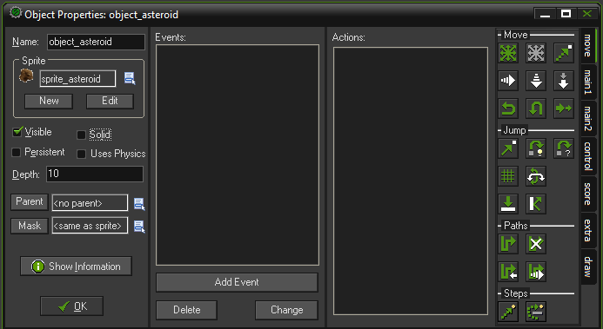
The Asteroid Object
From the Resources menu, choose Create Object
Create a new object called object_asteroid and give it the asteroid sprite.
On the left-hand side there is a text field labeled Depth. Enter 10 in this field to change the depth of the object from 0 to 10.
Game Development 1
Denis McCarthy

Slide 29
Adding Movement Action
Add a create event
We need to select the Move Free action from the move action tab category. Drag and drop the Move Fixed icon by holding down the left mouse button. An action form will then pop up asking for particular information about this action.

Slide 30
Adding Movement Action
When an asteroid is created, we want it to start moving in a completely random direction. To achieve this we enter the function random(360) into the direction field. This indicates a random direction between 0 and 360 degrees.
Set the speed 4.
Click on OK to create action.

Slide 31
Asteroid outside room
We also need to make sure that when the asteroid goes off the edge of the room, it reappears at the other side.
Again, to achive this we include the wrap function.
Game Development 1
Denis McCarthy

Slide 32
Outside Room Event
Click the Add Event button. The Event Selector appears as shown below.
Click the Other event and select Outside Room from the drop down menu that appears to add it to the list of events. This event will then be added and selected in the list of events.
Game Development 1
Denis McCarthy

Slide 33
Adding Wrap action
Include the Wrap Screen action in the Actions list.
In the form that appears, you should indicate that wrapping should occur in both directions (top to bottom and left to right).
Click on OK to finish.

Slide 34
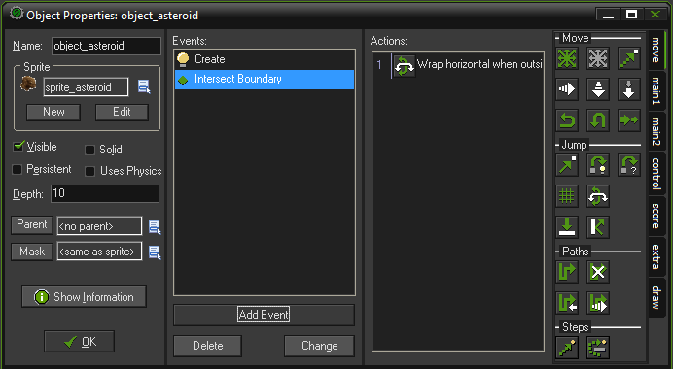
Asteroid object, complete so far…
That’s all the events and actions that we need for the Asteroid object right now.
Click OK at the bottom left of the form to close it.
Game Development 1
Denis McCarthy

Slide 35
How are we getting on...
Now would seem like a good time to check that everything has gone according to plan so far.
However, before we can do that we must create a room with some instances of moons and asteroids in it.
But, first we’ll create a background for our room...
Game Development 1
Denis McCarthy

Slide 36
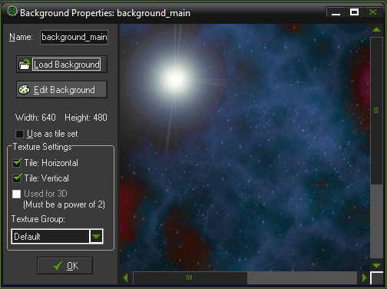
Creating a Background
We need to add a background to our room to make it look better, first we need to create a background resource.
Select Create Background from the Resources menu.
Call the background background_main and click on the Load Background button and choose the file Background.bmp.
Click OK to close the Background Properties form.

Slide 37
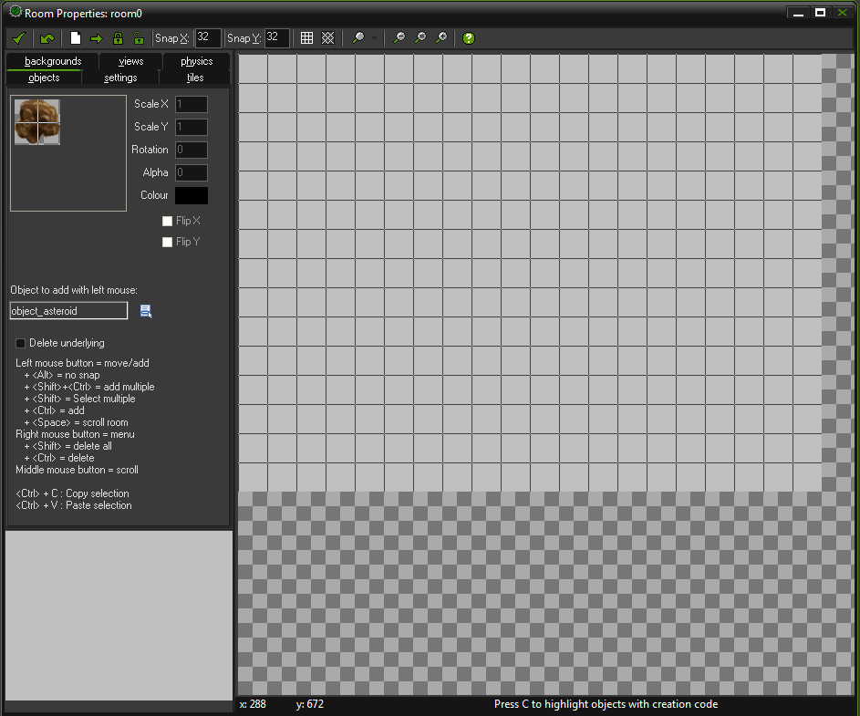
Creating a Room
From the Resources menu, choose Create Room, a Room Properties form will appear as below.

Slide 38
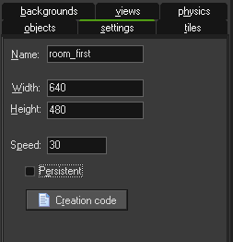
Creating our Room
Click on the settings tab in the top left of the form.
Enter the name for the room in the Name field. Call this one room_level1.
The width and height is the size of the room in pixels, 640 and 480 in this instance.
The speed is the number of steps per second. The higher the speed, the smoother the motion is. But you will need a faster computer to run it. We will set the speed to 30. You should experiment with other values
Game Development 1
Denis McCarthy

Slide 39
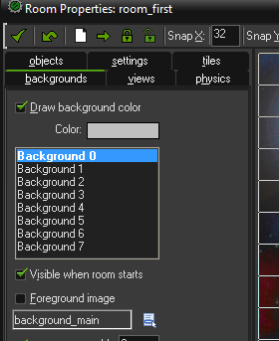
Adding Background to Room
Select the Backgrounds tab on the Room Properties form. Click the menu icon to the right of where it says <no background> and select the new background from the pop-up menu.
Game Development 1
Denis McCarthy

Slide 40
Adding Moons & Asteroids
Select the objects tab and place a number of asteroids and moons in the room.
(Remember that you can choose the object to place by clicking where it says “Object to add with left mouse”).
Close the Room Properties form by clicking the green checkmark in the top-left corner
Game Development 1
Denis McCarthy

Slide 41
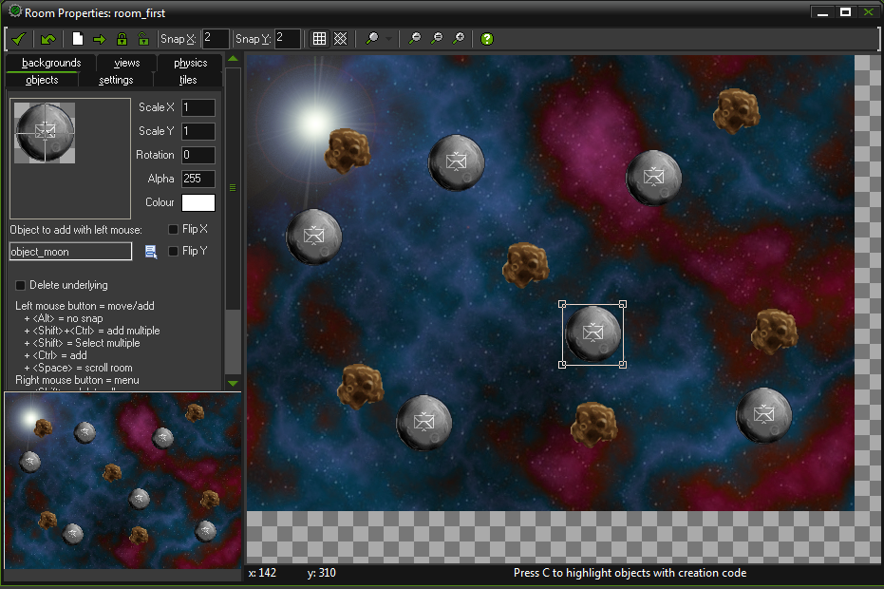
Current view of room
That should give us something to look at, so let’s give it a try.
Game Development 1
Denis McCarthy

Slide 42
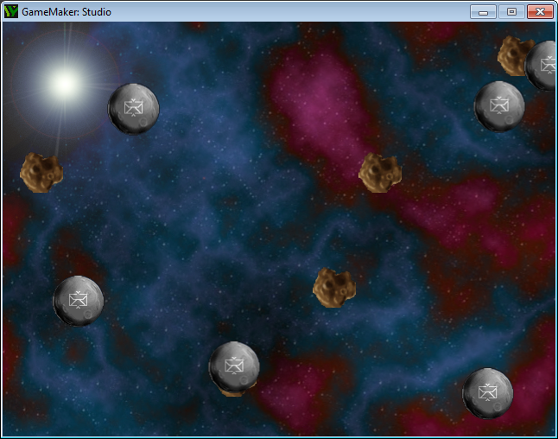
We can now test our game!
We have enough elements created that we can test the game.
To execute/run the game we click on the green play button on the toolbar.
Version 1 of our game:

Slide 43
Flying Around!
This isn’t a very interactive experience yet, so let’s introduce some game play by bringing the rocket into the game.
We’ve already mentioned that we’ll make two rocket objects, but let’s stop to consider why this is necessary.
Our rocket has two different ways of behaving: sitting on top of a moving moon with full control over the ship’s direction, and flying through space with only limited control.
Having two ways of controlling one object would involve a complicated set of events and actions, but if we separate these behaviors into two different objects, then it becomes quite simple.
Provided that both objects look the same, the player will never notice that their ship is actually changing from being a “flying rocket” object to a “landed rocket” object at different stages of the game.
Game Development 1
Denis McCarthy

Slide 44
Flying Around!
We also need two moon objects, as we want the landed rocket object to follow the path of one particular moon around (the one it has landed on).
Making it into a separate object will allow us to single it out from the others in this way.
As this second moon object will be almost the same as the normal moon, we can take a shortcut and make a copy of the existing moon object.
Game Development 1
Denis McCarthy

Slide 45
The Special Moon Object
Right-click the moon object in the resource list, and select Duplicate from the pop-up menu. A copy of the moon object will be added to the resource list and its properties form is displayed.
Change the name to object_specialmoon. It is important that you use this exact name (including the underscore) as we will use this to identify this object later on.
Game Development 1
Denis McCarthy

Slide 46
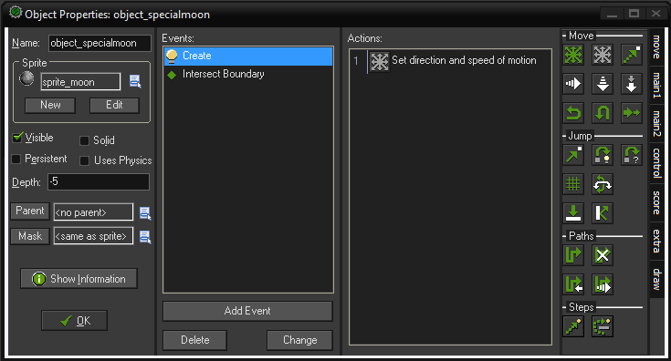
The Special Moon Object
Set the Depth of this object to -5. This will guarantee that instances of this moon are always in front of the other moons as it is lower than 0.
Game Development 1
Denis McCarthy

Slide 47
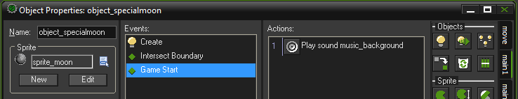
The Special Moon Object
We will also make this moon responsible for starting the background music at the beginning of the game.
Add an Other, Game start event and include a Play Sound action in it (main1 tab).
Select the background music sound and set Loop to true so that the music plays continuously.
Click OK to close the properties form.
Game Development 1
Denis McCarthy

Slide 48
Add special moon to room
Now open the first room and add a single instance of this new special moon to the level.
Run the game and the music should play. (You won’t notice any other difference because the special moon should look and behave exactly like the other moons.)
Now we can make our two rocket objects. We’ll begin with the landed rocket, which needs to sit on the special moon object until the player decides to blast off.
We’ll use a Jump Position action to make it follow the special moon’s position as it moves around the screen.
Game Development 1
Denis McCarthy

Slide 49
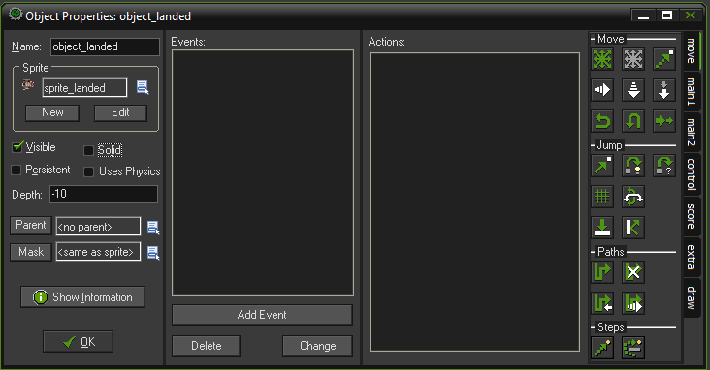
The landed Object
From the Resources menu, choose Create Object
In the Name field, give the object a name. You should call this one object_landed
Select the sprite_landed sprite. And set the Depth for this object to -10. So it appears in front of other objects.
Game Development 1
Denis McCarthy

Slide 50
The landed Object
Add a Step, End Step event to the new object.
An End Step allows actions to be performed immediately before instances are drawn at their new position on the screen.
Therefore, we can use this event to find out where the special moon has been moved to and place the rocket at the same location—just before both of them are drawn.
Game Development 1
Denis McCarthy

Slide 51
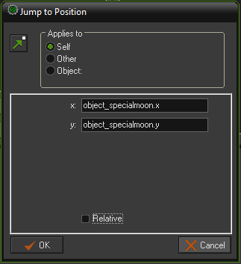
The landed Object
Include the Jump Position action in the Actions list for this event. This action allows us to move an object to the coordinates of any position on the screen.
Type object_specialmoon.x into the X value and object_specialmoon.y into the Y value. These indicate the x and y positions of the special moon.
Game Development 1
Denis McCarthy

Slide 52
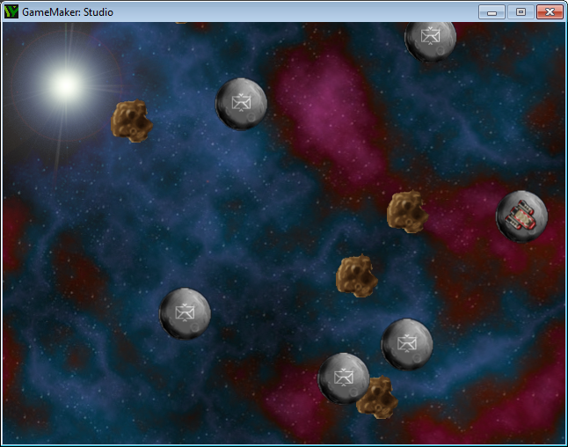
Test the game...
You might want to test the game now.
Place one instance of the rocket at a random position in the room and also add 1 specialmoon and run the game.
The rocket should jump to the position of the special moon and stay on top of it as it moves around.
Game Development 1
Denis McCarthy

Slide 53
Spinning out of control
When you run the game, you will also notice that the rocket continually spins around without any user input.
This is because the rocket sprite contains an animation showing the rocket rotating through 360 degrees.
By default, Game Maker automatically cycles through a sprite’s sub images to create an animation.
However, this is not what is needed for this game—we need Game Maker to select the appropriate sub image based on the direction the rocket is moving in.
Game Development 1
Denis McCarthy

Slide 54
Spinning out of control
This requires a small amount of mathematics.
There are 72 images representing a turn of 360 degrees, so each image must have been rotated by 5 degrees more than the last (because 360/72 = 5).
Game Maker stores the direction of all objects in degrees, so it can work out which rocket sub image to use by dividing the rocket object’s current direction by 5.
Therefore we can make the rocket face in the right direction by using this rule (direction/5) to set the current subimage in a Change Sprite action.
Game Development 1
Denis McCarthy

Slide 55
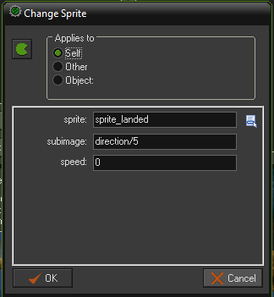
Change sprite action
With the landed rocket Object Properties form open, include a Change Sprite action (main1 tab) in its End Step event. Choose the landed rocket sprite from the menu and type direction/5 into the Subimage property. direction is a special term that Game Maker recognizes as meaning the direction that this instance is currently facing in.
Finally, set Speed to 0 to stop the sprite from animating on its own and changing the subimage.
Game Development 1
Denis McCarthy

Slide 56
Note on this method
This way of dealing with rotated images might seem rather clumsy, but many old arcade games were made in a similar way so that each rotated image could include realistic lighting effects.
Nonetheless, the registered version of Game Maker (which you have) contains an additional action to rotate a sprite automatically without the need for subimages at all.
We can also make use of this special term for the object’s direction to add actions that allow the player to control the direction of the rocket using the arrow keys.
Game Development 1
Denis McCarthy

Slide 57
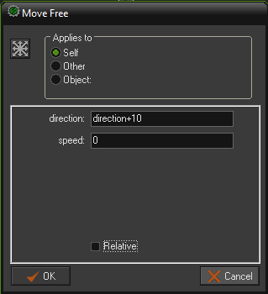
Left Keyboard event
Add a Keyboard, <Left> event to the landed rocket object.
Include the Move Free action and type direction+10 in the Direction property. This indicates that the current direction should be increased by 10 degrees. Set Speed to 0 because we don’t want the rocket to move independently of the special moon.
Game Development 1
Denis McCarthy

Slide 58
Right Keyboard event
Add a similar Keyboard event for the <Right> key. Include a Move Free action and type direction-10 in the Direction property.
The last control we need for the landed rocket will allow the player to launch the rocket using the spacebar.
This control will need to turn the landed rocket object into a flying rocket object, but we can’t make an action for this as we haven’t created the flying rocket object yet!
So we’ll make the flying rocket now and come back to this later.
Game Development 1
Denis McCarthy

Slide 59
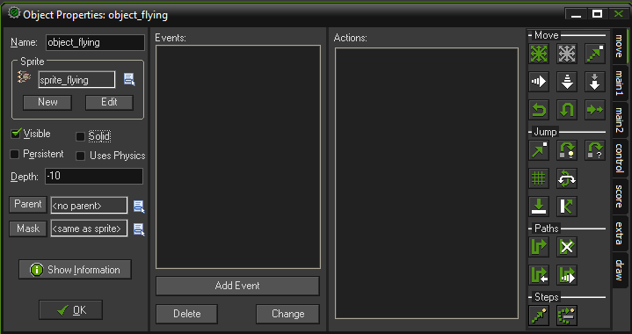
The Flying Object
From the Resources menu, choose Create Object
In the Name field, give the object a name. You should call this one object_flying
Select the sprite_flying sprite. And set the Depth for this object to -10. So it appears in front of other objects.
Game Development 1
Denis McCarthy

Slide 60
The Flying Object
Add an Other,Outside Room event and include a Wrap Screen action to wrap around the screen in both directions.
Add a End Step event. Include a Change Sprite action, choose the flying rocket sprite, type direction/5 in the Subimage property, and set the Speed to 0.
Add a Keyboard, <Left> event and include a Move Free action. We don’t want the player to have too much control over the flying rocket, so type direction+2 in Direction and set Speed to 6.
Add a Keyboard, <Right> event with a Move Free action. Type direction-2 in Direction and set Speed to 6.
Game Development 1
Denis McCarthy

Slide 61
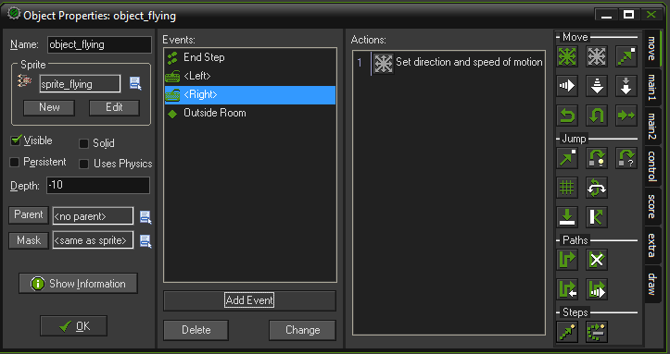
Flying object, complete so far…
That’s all the events and actions that we need for the Flying object right now.
Click OK at the bottom left of the form to close it.
Game Development 1
Denis McCarthy

Slide 62
Current situation
The basic game play is nearly there now—just a few more events to tie up.
First, the game should end when the rocket hits an asteroid.
Next, when the flying rocket reaches a moon, it should turn into a landed rocket, and the moon should turn into the special moon (so that the landed rocket can follow it).
We achieve this using the Change Instance action, which basically turns an instance from one type of object into another.
Game Development 1
Denis McCarthy

Slide 63
Current situation
To use a jelly comparison, this is a bit like melting down the jelly from one instance and putting it into a new object mold.
Although the instance may end up as a completely different kind of object, it keeps many of its original properties, such as its position on the screen and its direction.
The fact that these values remain the same is critical—otherwise the launch direction of the landed rocket would get reset as soon as it turned into a flying rocket!
Game Development 1
Denis McCarthy

Slide 64
Collisions with flying object
Reopen the Properties Form for the Flying object by double clicking on it.
Add a Collision event with the asteroid object and include the Restart Game action (main2 tab) in the Actions list. Later on we’ll include an explosion to make this more interesting.
Add a Collision event with the moon object and include the Change Instance action (main1 tab). Set the object to change into object_landed using the menu button, and leave the other options as they are.
Game Development 1
Denis McCarthy

Slide 65
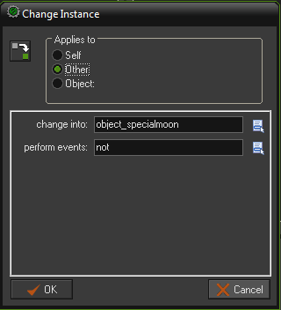
Collisions with flying object
Include a second Change Instance action for changing the moon into a special moon object. To make this action change the moon object (rather than the rocket), we need to switch the Applies to option from Self to Other. This makes the action apply to the other object involved in the collision, which in this case is the moon. Set the object to change into object_specialmoon.
Game Development 1
Denis McCarthy

Slide 66
Some tidying up...
Finally, we can go back to the landed rocket object. This will need an event that changes it into a flying rocket and deletes the special moon when the spacebar is pressed.
Reopen the Object Properties form for the landed rocket by double-clicking on it in the resource list.
Add a Key Press, <Space> event and include a Move Free action to set the rocket in motion. Type direction in the Direction property (this keeps the direction the same) and set Speed to 6.
Game Development 1
Denis McCarthy

Slide 67
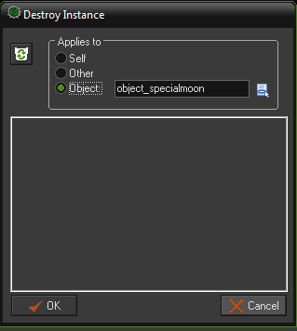
Some tidying up...
Now include a Change Instance action and change the object into an object_flying.
Finally, we want to delete the special moon because it no longer needs to be visited. Include a Destroy action and change the Applies to option to Object. Click the menu button next to this and select the object_specialmoon.
Game Development 1
Denis McCarthy

Slide 68
Note: Applies to...Object
Caution: Using the Object setting for Applies to performs an action on all instances of that kind of object in the room. Deleting all of the special moon instances is fine in this case (as there is only one), but you will need to think carefully about the effects this setting will have before using it in your own games.
Game Development 1
Denis McCarthy

Slide 69
So far...
That completes the second version of our game.
Make sure you save it and check that it all works as it should so far.
You should now be able to rotate the rocket on a moon, launch it with the spacebar, and steer through the asteroids to land on another moon.
Moons should disappear as you visit them, and the game should restart if you hit an asteroid.
If something is not working, then check the instructions again.
Game Development 1
Denis McCarthy

Slide 70
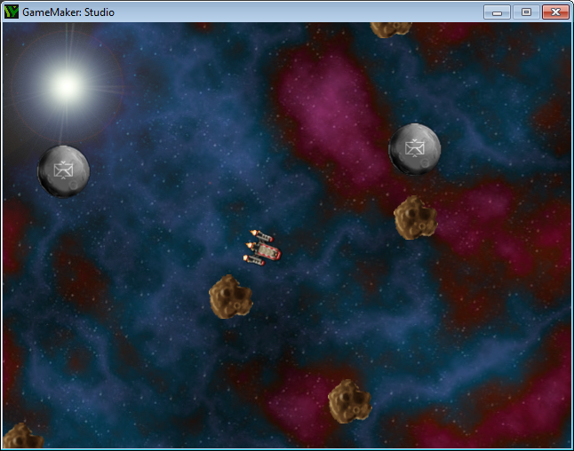
Current version
Game Development 1
Denis McCarthy

Slide 71
Current version
There are clearly a number of things still missing from the game, but the game is already quite fun to play.
In the next section, we will add a scoring mechanism and a high-score table, as well as advancing the player to a new level once mail has been delivered to all the moons.
Game Development 1
Denis McCarthy

Slide 72
Winning and Losing
In this section we’ll put a bit more effort into what happens when the player wins or loses the game.
Let’s begin by making asteroids a bit more explosive!
Explosions
To get this working, we’ll add a new explosion object and create an instance of it when the rocket hits an asteroid.
This will play the explosion sound when it is created and end the game with a high-score table after the explosion animation has finished.
Game Development 1
Denis McCarthy

Slide 73
Explosion Obejct
Create a new object called object_explosion, and select the explosion sprite. Give it a Depth of -10 to make it appear in front of other instances.
Add a Create event and include a Play Sound action (main1 tab) for the explosion sound. Set loop to false.
Add an Other, Animation End event. This event happens when a sprite reaches the final subimage in its animation.
Game Development 1
Denis McCarthy

Slide 74
Explosion Obejct
Also include a Restart Game action to start the game again after the high-score table is closed (main2 tab).
Click OK to close the object.
Next we have to change the behavior of the flying rocket when it hits an asteroid.
Game Development 1
Denis McCarthy

Slide 75
Updating the flying Obejct
Reopen the properties form for the flying rocket object by double-clicking on it in the resource list.
Select the Collision event with the asteroid by clicking on it once. Click once on the Restart Game action and press the Delete key to remove it from the action list.
Include a Create Instance action (main1 tab) in its place, and set it to create the explosion object. Make sure the Relative property is enabled so that the explosion is created at the current position of the rocket.
Game Development 1
Denis McCarthy

Slide 76
Updating the flying Obejct
Include a Destroy Instance action (main1 tab) and leave it set to Self so that the rocket gets deleted. Click OK on the properties form to finish.
You might want to run the game now to see how it looks.
Try colliding with an asteroid and you should get an explosion followed by the room restarting. Unfortunately, you can’t score any points yet, so let’s add this next.
Game Development 1
Denis McCarthy

Slide 77
Scores
If you’ve played the game quite a bit already, then you may have noticed a way of “cheating.”
You can avoid the risk of hitting asteroids by waiting for another moon to fly right next to your own and then quickly hop between moons.
The game can become a lot less fun once this technique has been discovered, so our scoring system is designed to discourage the player from playing this way.
Game Development 1
Denis McCarthy

Slide 78
Scores
Although they receive points for delivering mail, they also lose point for waiting on moons.
This means that a player that takes risks by launching their rocket as soon as possible not only will have the most enjoyable playing experience but will also score the most points.
Game Development 1
Denis McCarthy

Slide 79
Updating objects to include scoring
Reopen the properties form for the special moon object and select the Game Start event. Include a Set Score action with a New Score of 1000. This gives the player some points to play with at the start. Close the properties form.
Reopen the properties form for the landed rocket and select the End Step event. Include a Set Score action with New Score as -1 and the Relative option enabled. This will repeatedly take 1 point off the score for as long as the player remains on a moon. As there are 30 steps every second, they will lose 30 points for every second of hanging around. Close the properties form.
Game Development 1
Denis McCarthy

Slide 80
Updating objects to include scoring
Reopen the properties form for the flying rocket and select the Collision event with the moon object. Include a Set Score action with a New Score of 500 and the Relative option enabled.
Include a Play Sound action after setting the score and select the bonus sound. Set the Loop to false.
Game Development 1
Denis McCarthy

Slide 81
Updating objects to include scoring
We need to update the highscore if we collide with an asteroid (i.e. The game is over)
Reopen the properties form for the explosion and select the Animation End. Before the restart action include a Test Score action with a value of highscore_value(1) and the operation option larger than.
Also before the restart action Include an Execute a piece of code action (control tab) with just highscore_add(“”,score); in it.
Game Development 1
Denis McCarthy

Slide 82
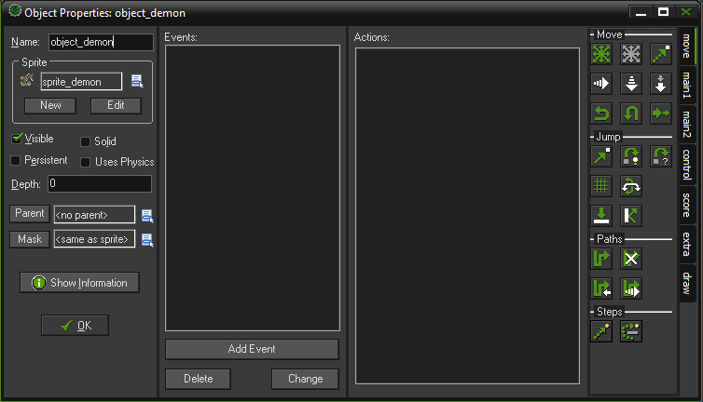
Displaying the Score
From the Resources menu, choose Create Object
In the Name field, give the object a name. You should call this one object_controller
Game Development 1.1
Denis McCarthy

Slide 83
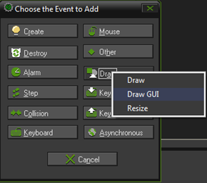
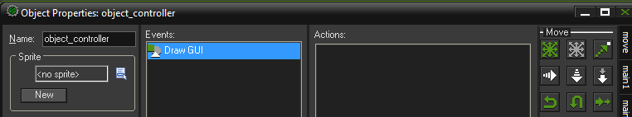
Adding events to Controller
Click the Add Event button. The Event Selector appears as shown below.
Click the Draw, Draw GUI event and this event will then be added and selected in the list of events.

Slide 84
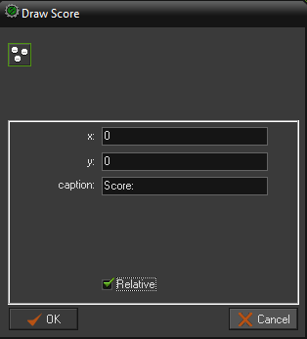
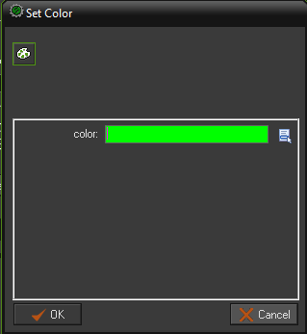
Adding the Draw Score events
Add a SetColor action from the drawaction tab category. (Pick a colour that will be visible)
We need to select the Draw Score action from the score action tab category.
In the action form, select the relative where you place the object.

Slide 85
Adding the Draw Score events
We need to select the Execute a piece of code action from the control action tab category.
Simply write highscore_value(1) and the x to 300. leave the y alone.
In the action form, select the relative where you place the object.
Place a controller obejct in your room near the top left.

Slide 86
Levels
At the moment, there is no reward for delivering all the mail. In fact, once all the moons are removed, the rocket just flies through space until it collides with an asteroid!
This seems rather unfair, and it would be much better if the player advanced to a more difficult level. Making
multiple levels in Game Maker is as simple as making new rooms.
We can use actions to move between these rooms, and include more asteroids in the later levels to make them more difficult to play.
Game Development 1
Denis McCarthy

Slide 87
Levels
Let’s begin by creating the new levels. You’ll repeat these steps to make two more levels so that there are three in total. You can always add more of your own later on.
Note: The order of the rooms in the resource list determines the order of your levels in the game, with the top level being first and the bottom level last. If you need to change the order, just drag and drop them into new positions into the list.
Game Development 1
Denis McCarthy

Slide 88
New levels (Rooms)
Right-click on a room in the resource list and choose Duplicate from the pop-up menu. This will create a copy of the level.
Go to the settings tab and give the room an appropriate name (room_level1, room_level2, etc.).
Switch to the objects tab, and add or remove instances using the left and right mouse buttons.
Make sure that each level contains exactly one special moon and one instance of the landed rocket.
Game Development 1
Denis McCarthy

Slide 89
New levels (Rooms)
In order to tell Game Maker when to move on to the next room, we have to be able to work out when there are no moons left in the current one.
To do this, we will use a conditional action that asks the question “Is the total number of remaining moons equal to zero?” If the answer is yes (or in computer terms, true), then a block of actions will be performed; otherwise the answer is no (or false), and this block of actions is skipped.
We’ll put this check in the collision event between the flying rocket and the moon, so that players complete the level as soon as they hit the final moon.
Game Development 1
Denis McCarthy

Slide 90
Conditional Questions
All conditional actions ask questions like this, and their icons are octagon-shaped with a blue background so that you can easily recognize them.
Game Development 1
Denis McCarthy

Slide 91
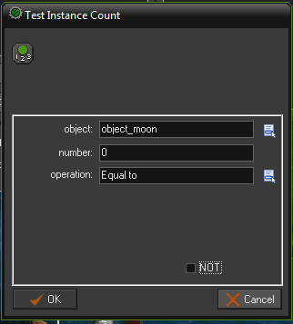
Test Instance Count
Reopen the properties form for the flying rocket and select the Collision event with the moon object.
At the end of the current list of actions, include the Test Instance Count action (control tab). Set the Object field to object_moon and the other settings will default to how we need them (Number, 0 and Operation, Equal to). This is now equivalent to the question “Is the total number of remaining moons equal to zero?”
Game Development 1
Denis McCarthy

Slide 92
No Moons Left?
Below this action we need to start a block. A block indicates that a number of actions are grouped together as part of a conditional action. This means that all of the actions in the block will be performed if the condition is true and none of them if it is not. Add the Start Block action (control tab) directly below the condition to test the instances.
Normally you would give the player a break by pausing for a few moments but Game Maker Studio has removed this option so it will not interfere with mobile devices.
Game Development 1
Denis McCarthy

Slide 93
No Moons Left?
We’ll award the player an extra bonus score of 1,000 points when they finish a level. Include a Set Score action (score tab) with a New Score of 1000 and make sure that the Relative option is enabled.
Include the Next Room action from the main1 tab to move to the next room. No properties need to be set here.
Finally, add the End Block action (control tab) to end the block of the conditional action. The completed set of actions should now look like next slide. Note that the actions in the block are indented so that you can easily see that they belong together.
Game Development 1
Denis McCarthy

Slide 94
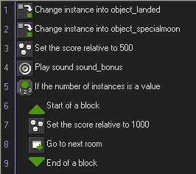
No Moons Left?
Game Development 1
Denis McCarthy

Slide 95
Test game again...
It is time to try out the game again. Save and play the game to check that you can go from one level to the next by visiting all the moons.
However, if you complete the game you’ll get an error message indicating that it has run out of levels. Don’t worry—this is something we will fix in a moment, when we add some more finishing touches to the game.
Game Development 1
Denis McCarthy

Slide 96
Finishing Touches
To finish our game, we’ll add an opening title screen, a help screen, and a congratulatory message upon completing the game.
We’ll also include a few visual touches to add a little bit of variety in the moons and asteroids.
Game Development 1
Denis McCarthy

Slide 97
Title Screen
Create a new sprite called sprite_title using Title.gif.
Create a new object called object_title and give it this sprite. Set the Depth property to 1 so that the moons go in front of it and the asteroids behind.
Add a Create event. This will contain the actions to start the music and set the score, but we’ve already created these in the special moon object, so we can simply move them over.
Open the special moon Object Properties form from the resource list and select the Game Start event to view its actions.
Game Development 1
Denis McCarthy

Slide 98
Title Screen
Drag and drop the two actions from the special moon Game Start event into the Create event of the title object. The Game Start event in the special moon should now be empty, and so it will delete itself automatically when the Object Properties form is closed. Do this now by clicking OK on the special moon’s properties form.
Add a Key Press, <Any key> event to the title object and include the Next Room action in the action list for this event (main1 tab).
Next we need to create a new room for the title screen.
Game Development 1
Denis McCarthy

Slide 99
Title Screen Room
Create a new room called room_title and give it an appropriate caption. Also set the room’s background in the same way as before.
Add a few moon and asteroid instances to the room (just for effect).
Place an instance of the new title screen object in the center of the room.
Close the room properties.
To make sure that this is the first room in the game, drag the new room to the top of the list of rooms in the resource list.
Now quickly test the game to check that this all works correctly.
Game Development 1
Denis McCarthy

Slide 100
Winning the game
We also need to stop the game from producing an error at the end and congratulate the player instead.
Similar to how we created the title room, we will create a finish room with a finish object to display the message and restart the game.
Game Development 1
Denis McCarthy

Slide 101
Finished Object
Create a new object called object_finish. It doesn’t need a sprite.
Add a Create event to the object and include the Display Message action in it (main2 tab). Set the Message to something like: “Congratulations! You’ve delivered all the mail.”
Include a Set Score action, with a New Score of 2000 and the Relative option enabled.
Game Development 1
Denis McCarthy

Slide 102
Finished Object
Include a Test Score action with a value of highscore_value(1) and the operation option larger than.
Include an Execute a piece of code action (control tab) with just highscore_add(“”,score); in it.
Finally, include the Restart Game action.
Game Development 1
Denis McCarthy

Slide 103
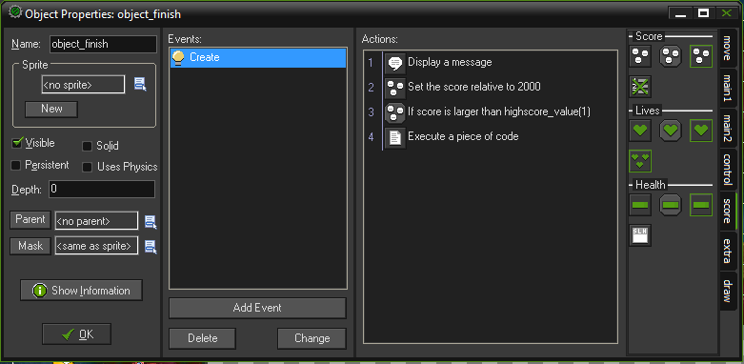
Finished Object
Now that we have the object, we can create a room for it to go in.
Game Development 1
Denis McCarthy

Slide 104
Finished Room
Create a new room and place one instance of the new finish object inside it. As this object has no sprite, it will appear as a blue ball with a red question mark on it. This will not appear in the game, but it reminds us that this (invisible) object is there when we are editing the room.
Now test the game to check that you can complete it—and that you get the appropriate message when you do (in other words, not an error message!)
Game Development 1
Denis McCarthy

Slide 105
Adding some visual variety
At the moment all the moons look exactly the same, and the asteroids even rotate in unison as they move around the screen.
However, with a different moon sprite and a little use of the random command, we can soon change this.
Game Development 1
Denis McCarthy

Slide 106
Moons and Asteroids
Open the properties form for the moon object and click the Edit button below the name of the object’s sprite (this is just another way of opening the moon sprite’s properties).
In the moon sprite’s properties, click Load Sprite and select Bases.gif instead of the existing sprite. This sprite contains eight subimages showing different kinds of inhabitations on each moon. Make sure to centre its origin. Click OK to close the Sprite Properties form.
Game Development 1
Denis McCarthy

Slide 107
Moons and Asteroids
Back in the moon Object Properties form, select the Create event and include a new Change Sprite action. Select the moon sprite and type random(8) in the Subimage property. This will randomly choose one of the inhabited moon sprites. Also set Speed to 0 to stop the sprite from animating on its own and changing the subimage.
Close the Action Properties and the moon Object Properties forms.
Game Development 1
Denis McCarthy

Slide 108
Moons and Asteroids
Include an identical Change Sprite action to the Create event of the special moon object in the same way. There is no need to edit the moon sprite again, as both objects use the same one.
Open the properties form for the asteroid object and include a new Change Sprite action in its Create event as well. This time choose the asteroid sprite, and type random(180) in the Subimage property. There are 180 images in the rotating asteroid animation, so this will start each one at a different angle. Also type random(4) in the Speed property so that asteroids rotate at different speeds.
Game Development 1
Denis McCarthy

Slide 109
Congratulations
Congratulations! You’ve now completed your thrid game with Game Maker. You might want to experiment with the game a bit further before continuing as there is much more you could do with it.
To start with, you could make more levels with faster-moving asteroids or smaller moons to make it harder to land on them.
Included are both larger planet sprites and smaller planetoids for you to experiment with, so see what you can come up with.
Game Development 1
Denis McCarthy

Slide 110
Congratulations
This chapter has introduced you to more features of Game Maker.
In particular you’ve made use of events and actions to change sprites and objects.
You’ve also used the Depth property of objects to control the order in which the instances appear on the screen.
This chapter has also introduced variables for the first time, even though we haven’t called them that yet.
Game Development 1
Denis McCarthy

Slide 111
Congratulations
For example, the word direction is a variable indicating the current direction of an instance.
We also used the variables x and y that indicate the position of an instance.
There are many variables in Game Maker, and they are extremely useful. We will see plenty more of them in the chapters to follow.
In the next chapter, we’ll continue to build on what you’ve learned so far by creating a crazy action game that requires quick thinking to avoid being squished. It’s amazing what can go on in a deserted warehouse . . .
Game Development 1
Denis McCarthy

